Slide 1

FruitPunch AI Code
Linear Regression
04.06.2019
M. Alican Noyan

Slide 2
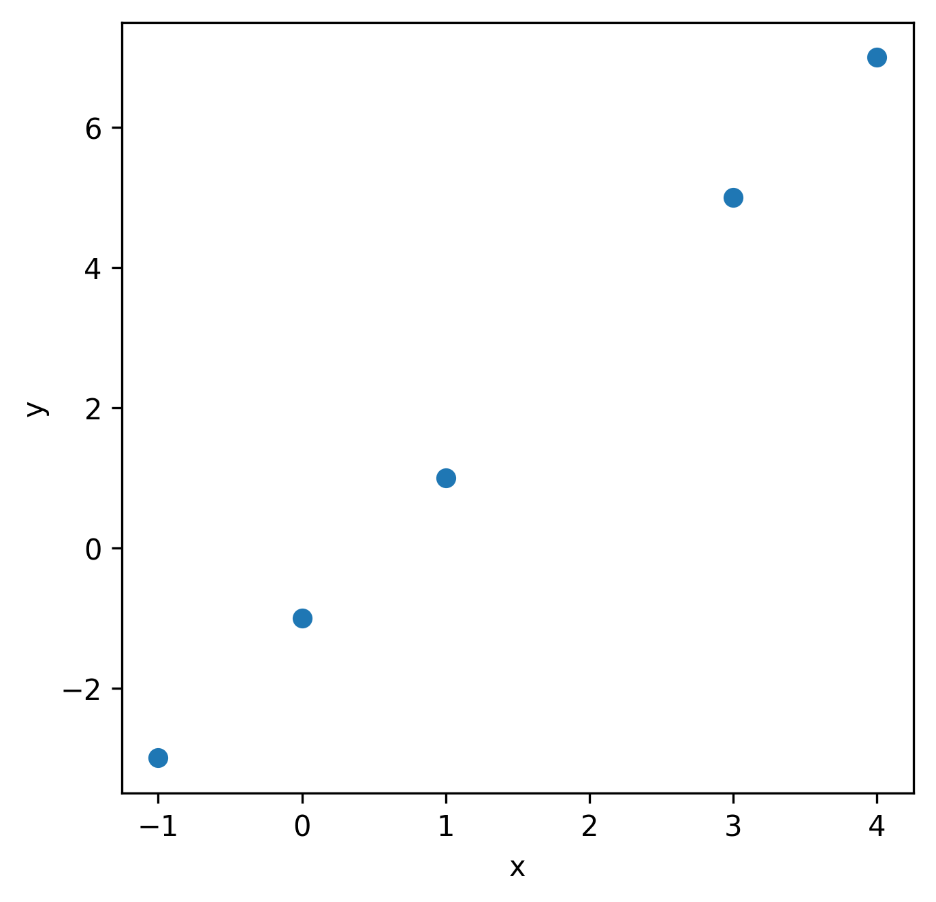
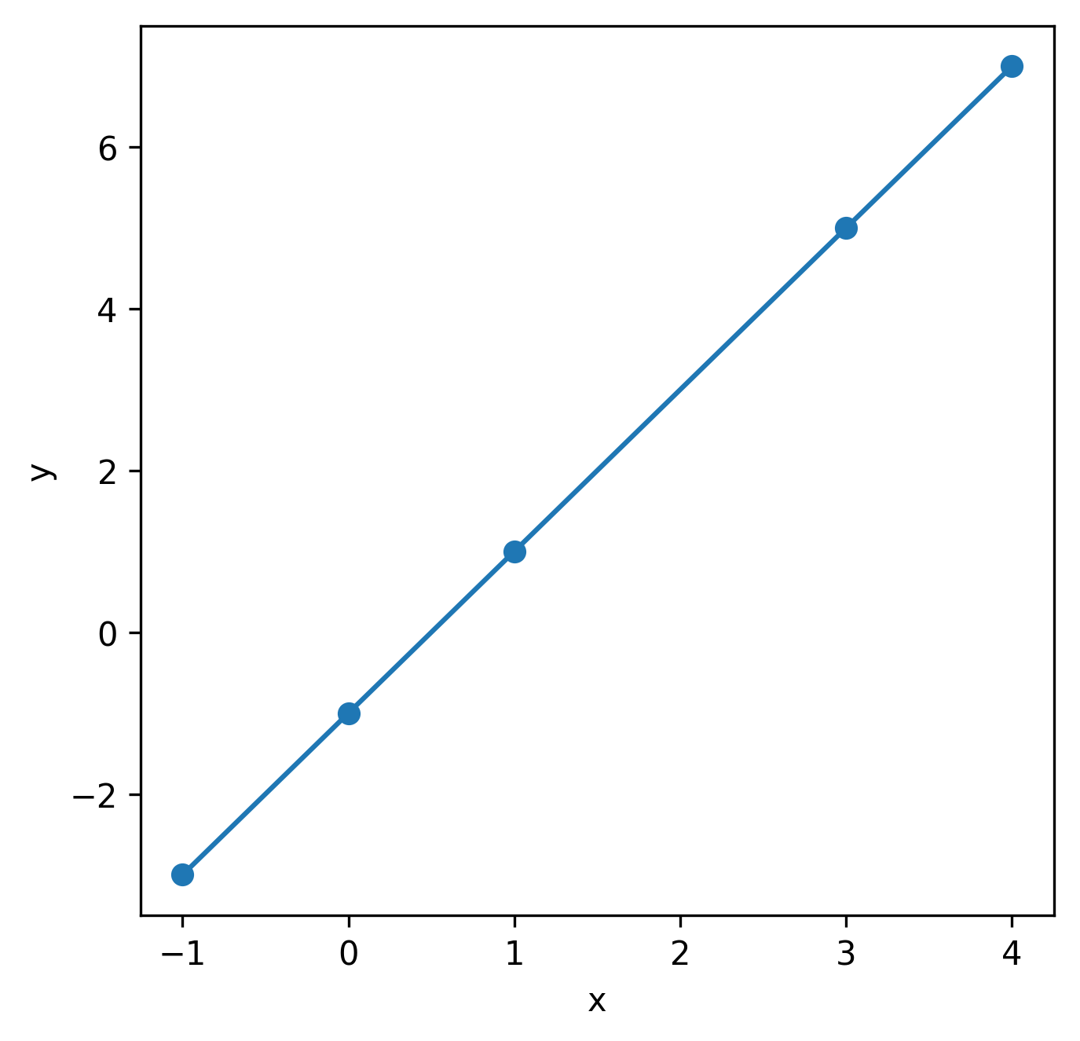
A question
?
-1
0
1
3
4
-3
-1
1
5
7
y = 2x -1

Slide 3
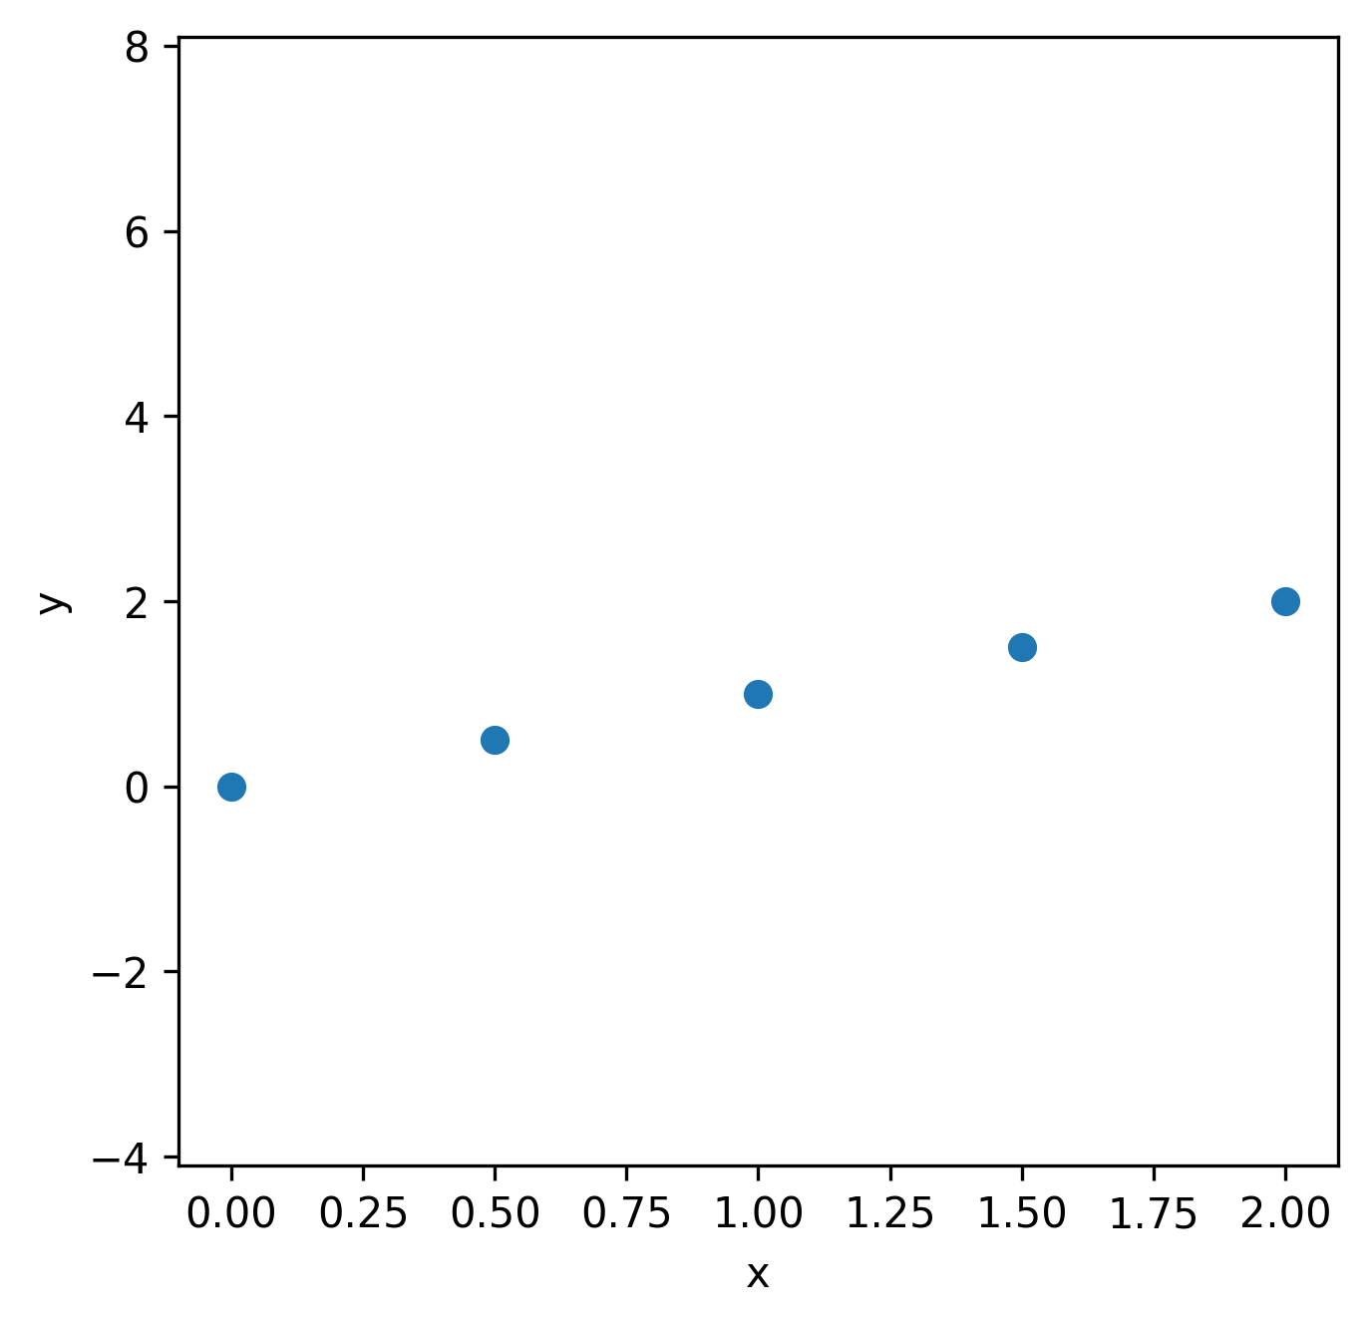
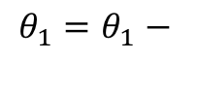
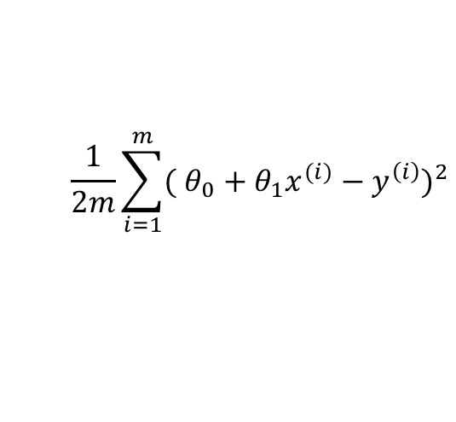
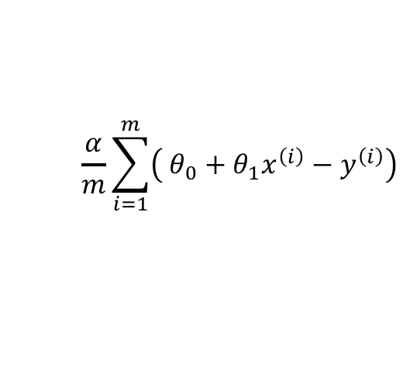
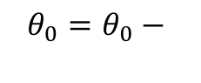
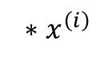
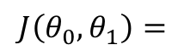
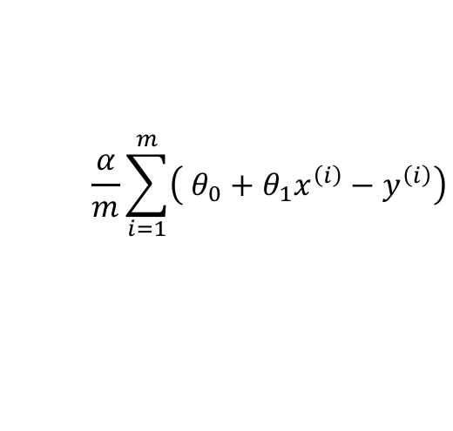
The Challenge
$$\frac{1}{2m}\sum_{i=1}^{m}{{( θ_{0}+θ_{1}x^{(i)}−y^{\left(i\right)})}^{2}}$$
$$J\left(θ_{0},θ_{1}\right)=$$
$$\frac{α}{m}\sum_{i=1}^{m}{\left( θ_{0}+θ_{1}x^{\left(i\right)}−y^{\left(i\right)}\right)}$$
$$θ_{0}=θ_{0}−$$
$$\frac{α}{m}\sum_{i=1}^{m}{\left( θ_{0}+θ_{1}x^{\left(i\right)}−y^{\left(i\right)}\right)}$$
$$θ_{1}=θ_{1}−$$
$${ ∗x}^{\left(i\right)}$$
Repeat until convergence

Slide 4
AI vs. Linear Regression
AI
Rule based
Machine Learning
Unsupervised
Supervised
Linear Regression

Slide 5


House price prediction

Slide 6

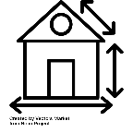
House price prediction
Size (m²) | Price (€)
40 | 150,000
45 | 170,000
…
100 | 310,000
(x^{(i)}, y^{(i)})
m = 27
x⁽²⁾
y⁽²⁾
x
x
n = 1
x
x
x
x
x
x
x
x
x
x
x
x
x
x
x
x
x
x
x
x
x
x
x
x
x

Slide 7
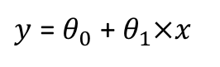
House price prediction
Size (m²) | Price (€)
40 | 150,000
45 | 170,000
…
100 | 310,000
(x^{(i)}, y^{(i)})
m = 27
x⁽²⁾
y⁽²⁾
n = 1
70
$y$ = $θ_{0}$ + $θ_{1}×x$

Slide 8
House price prediction
Size (m²) | Price (€)
40 | 150,000
45 | 170,000
…
100 | 310,000
(x^{(i)}, y^{(i)})
m = 27
x⁽²⁾
y⁽²⁾
x
x
n = 1
x
x
x
x
x
x
x
x
x
x
x
x
x
x
x
x
x
x
x
x
x
x
x
x
x
$y$ = $θ_{0}$ + $θ_{1}×x$

Slide 9
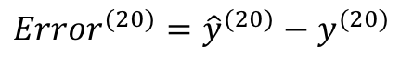
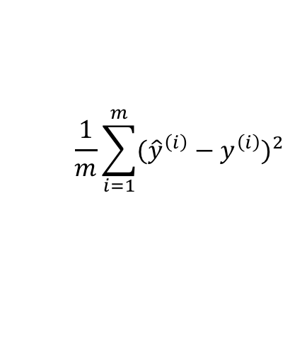
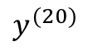
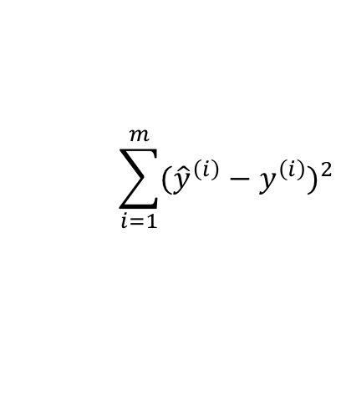
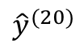
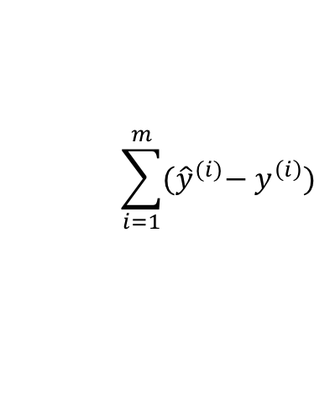
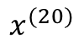
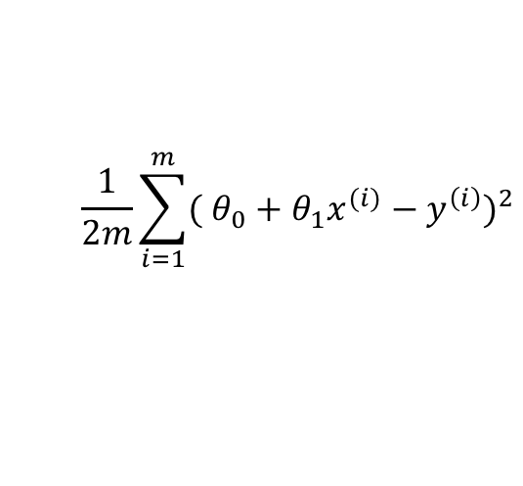
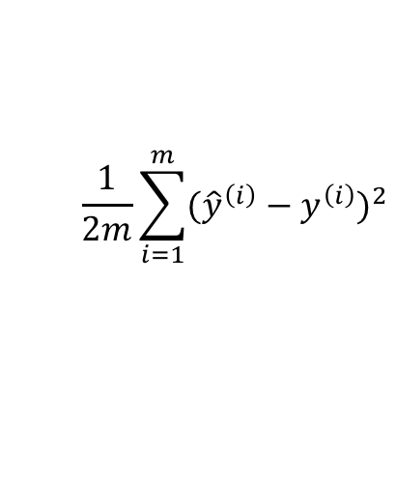
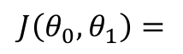
House price prediction
Size (m²) | Price (€)
40 | 150,000
45 | 170,000
…
100 | 310,000
(x^{(i)}, y^{(i)})
m = 27
x⁽²⁾
y⁽²⁾
x
x
n = 1
x
x
x
x
$$\sum_{i=1}^{m}{{(\hat{y}}^{(i)}− y^{\left(i\right)})}$$
$${\hat{y}}^{(20)}$$
x
x
x
x
$${{Error}^{(20)}=\hat{y}}^{(20)}−y^{(20)}$$
$$y^{(20)}$$
x
x
x
x
x
$$\sum_{i=1}^{m}{{({\hat{y}}^{\left(i\right)}−y^{\left(i\right)})}^{2}}$$
x
x
x
x
x
x
x
x
x
$$\frac{1}{m}\sum_{i=1}^{m}{{({\hat{y}}^{\left(i\right)}−y^{\left(i\right)})}^{2}}$$
x
x
x
$$\frac{1}{2m}\sum_{i=1}^{m}{{({\hat{y}}^{\left(i\right)}−y^{\left(i\right)})}^{2}}$$
$$x^{(20)}$$
$$\frac{1}{2m}\sum_{i=1}^{m}{{( θ_{0}+θ_{1}x^{(i)}−y^{\left(i\right)})}^{2}}$$
$$J\left(θ_{0},θ_{1}\right)=$$
$y$ = $θ_{0}$ + $θ_{1}×x$

Slide 10
Minimize a simplified J

Slide 11
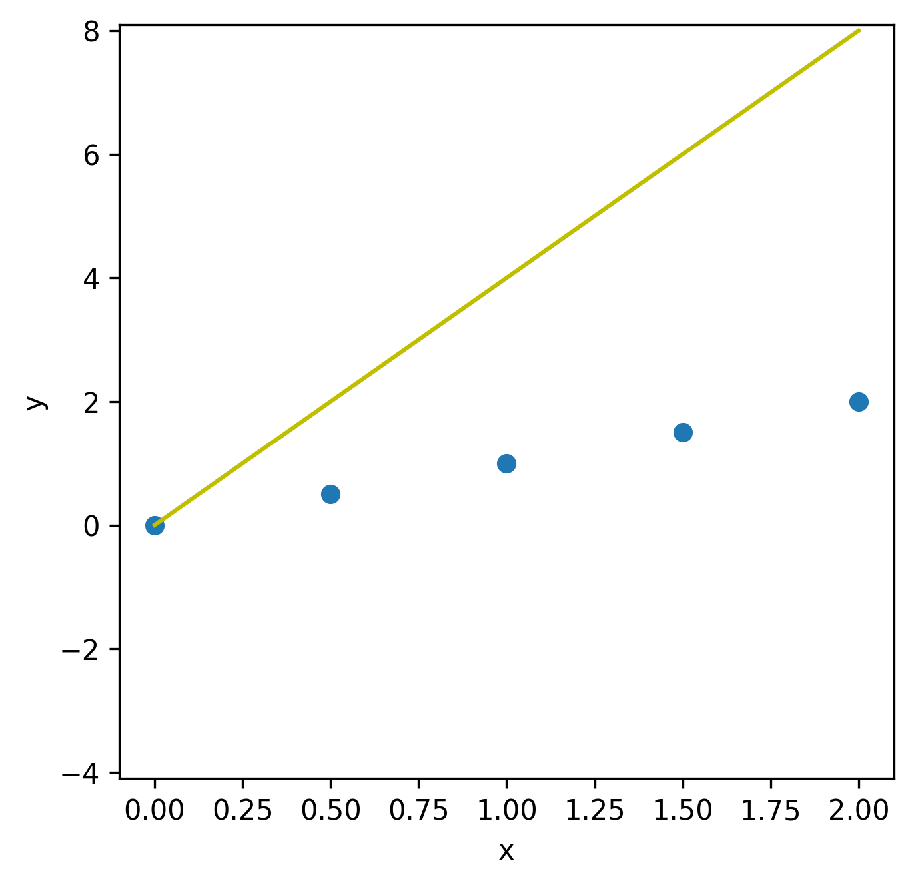
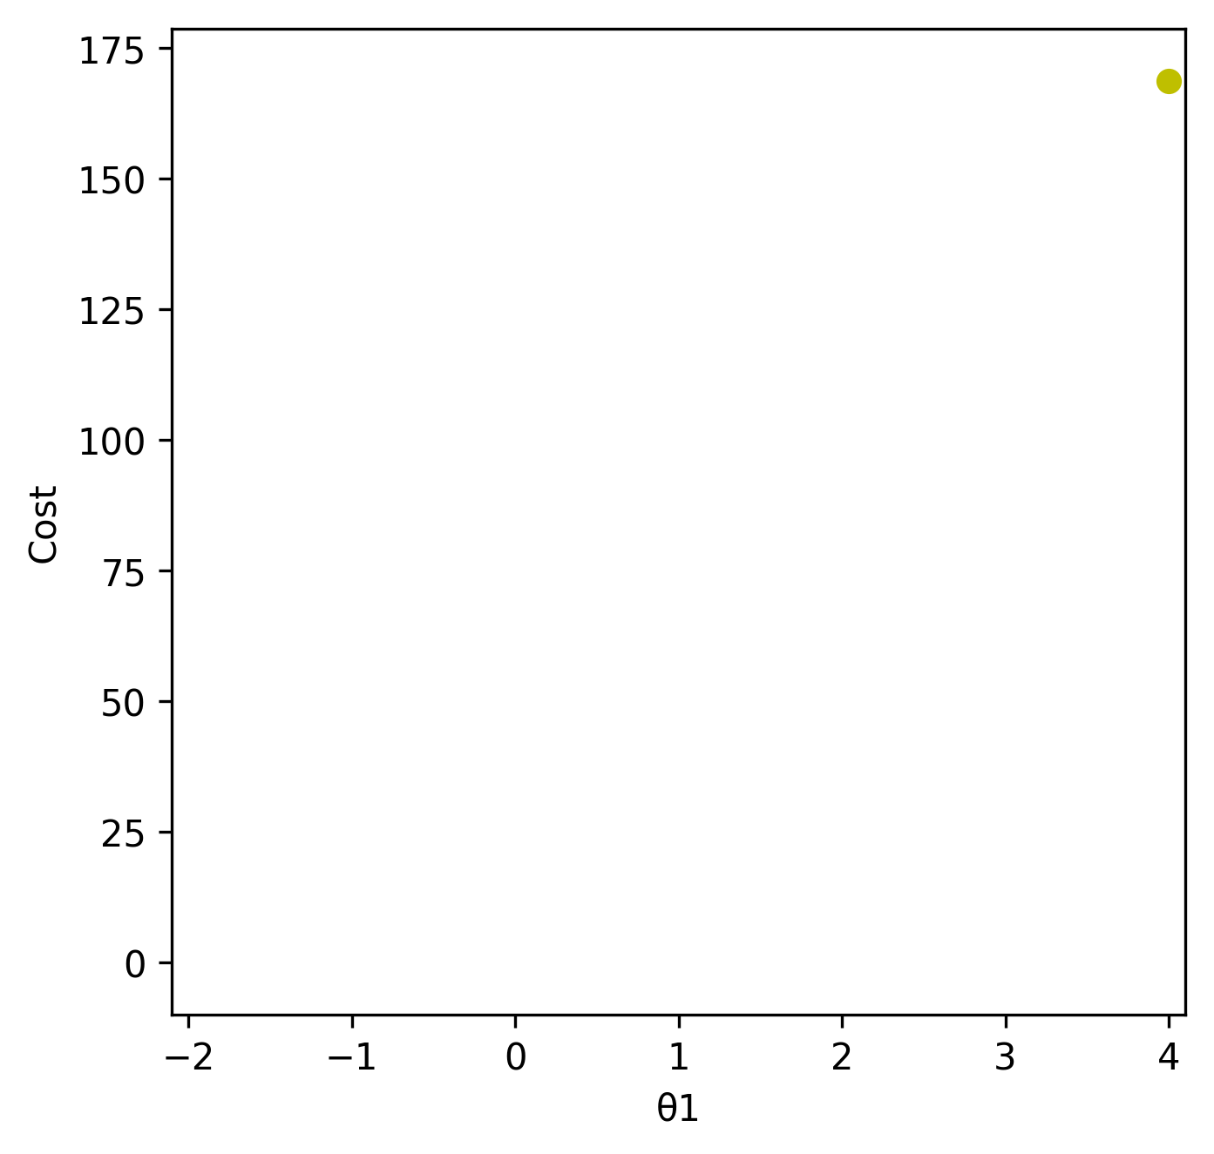
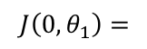
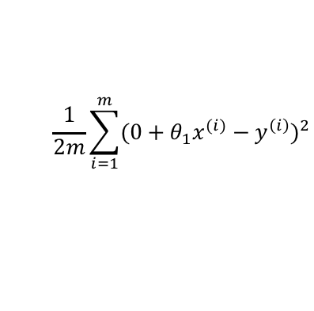
Minimize a simplified J
$$\frac{1}{2m}\sum_{i=1}^{m}{{(0+θ_{1}x^{(i)}−y^{\left(i\right)})}^{2}}$$
$$J\left(0,θ_{1}\right)=$$

Slide 12
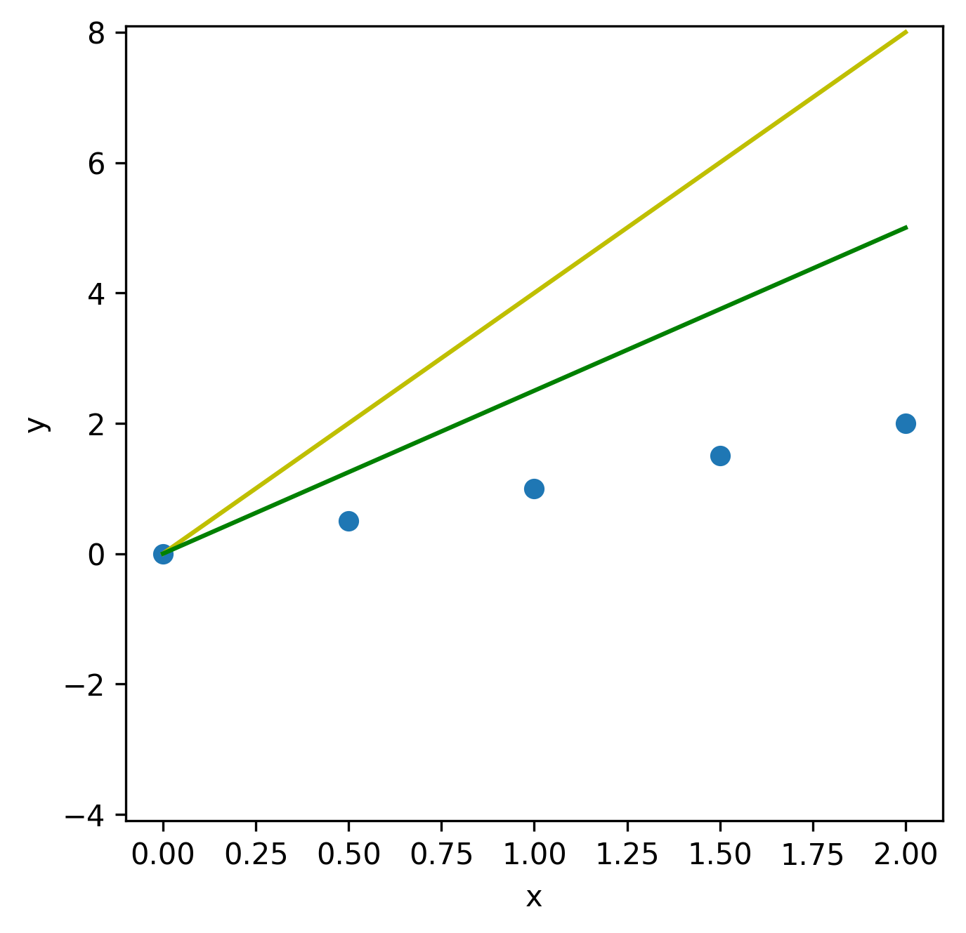
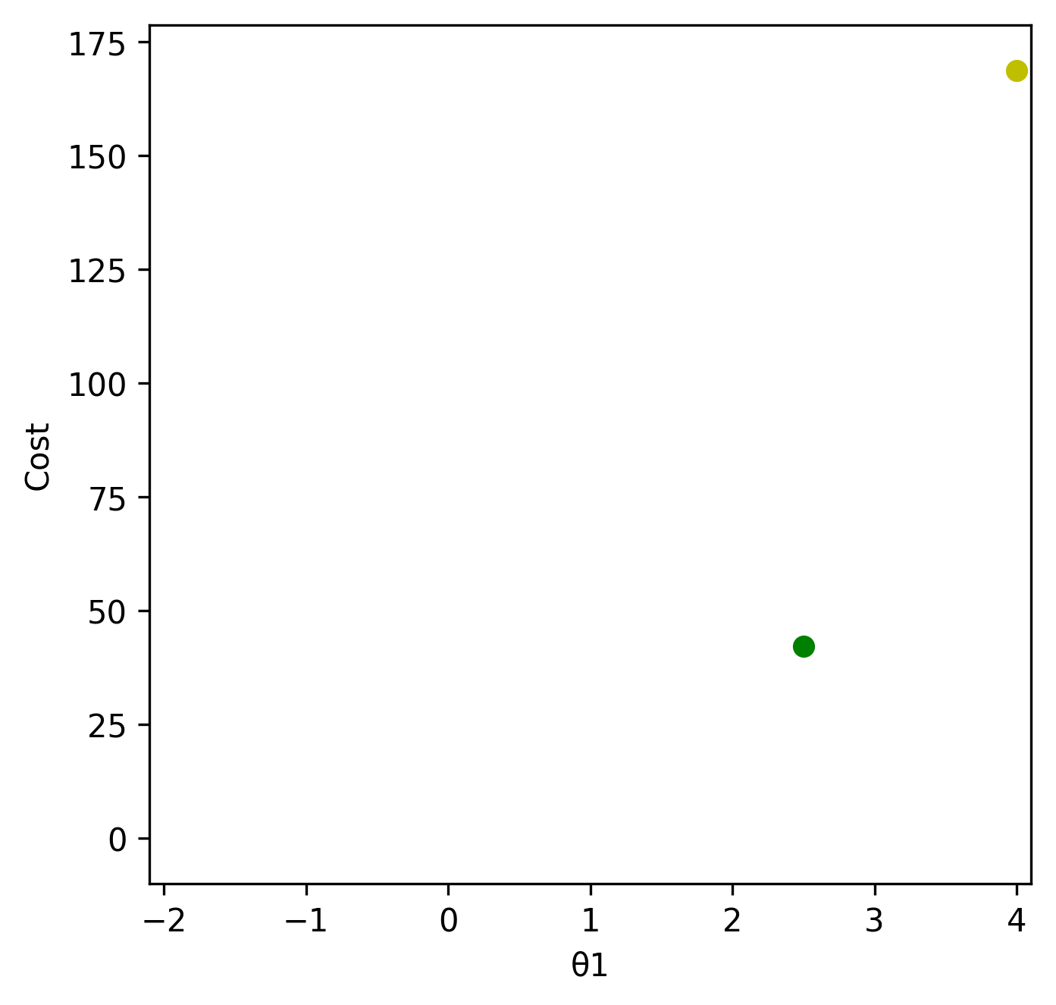
Minimize a simplified J
$$\frac{1}{2m}\sum_{i=1}^{m}{{(0+θ_{1}x^{(i)}−y^{\left(i\right)})}^{2}}$$
$$J\left(0,θ_{1}\right)=$$

Slide 13
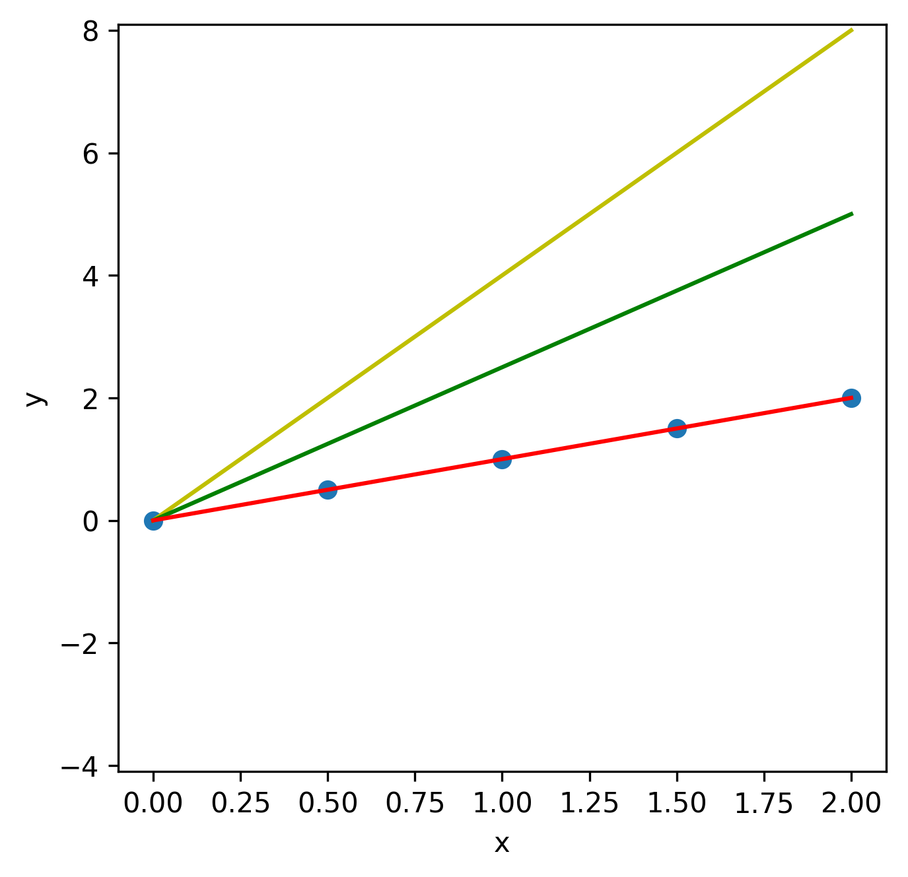
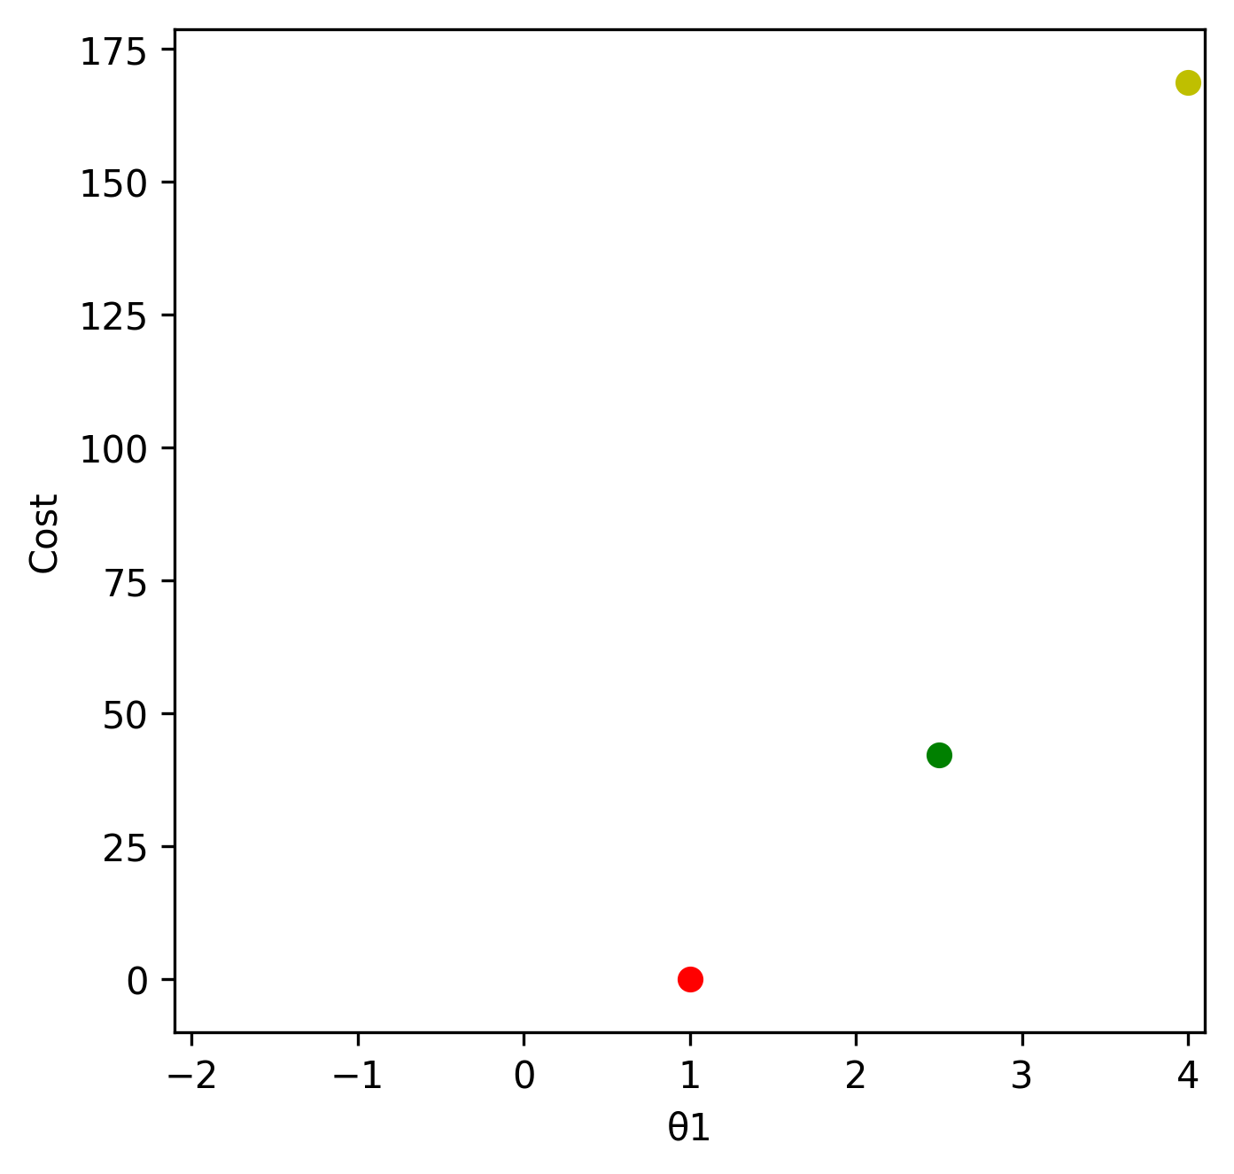
Minimize a simplified J
$$\frac{1}{2m}\sum_{i=1}^{m}{{(0+θ_{1}x^{(i)}−y^{\left(i\right)})}^{2}}$$
$$J\left(0,θ_{1}\right)=$$

Slide 14
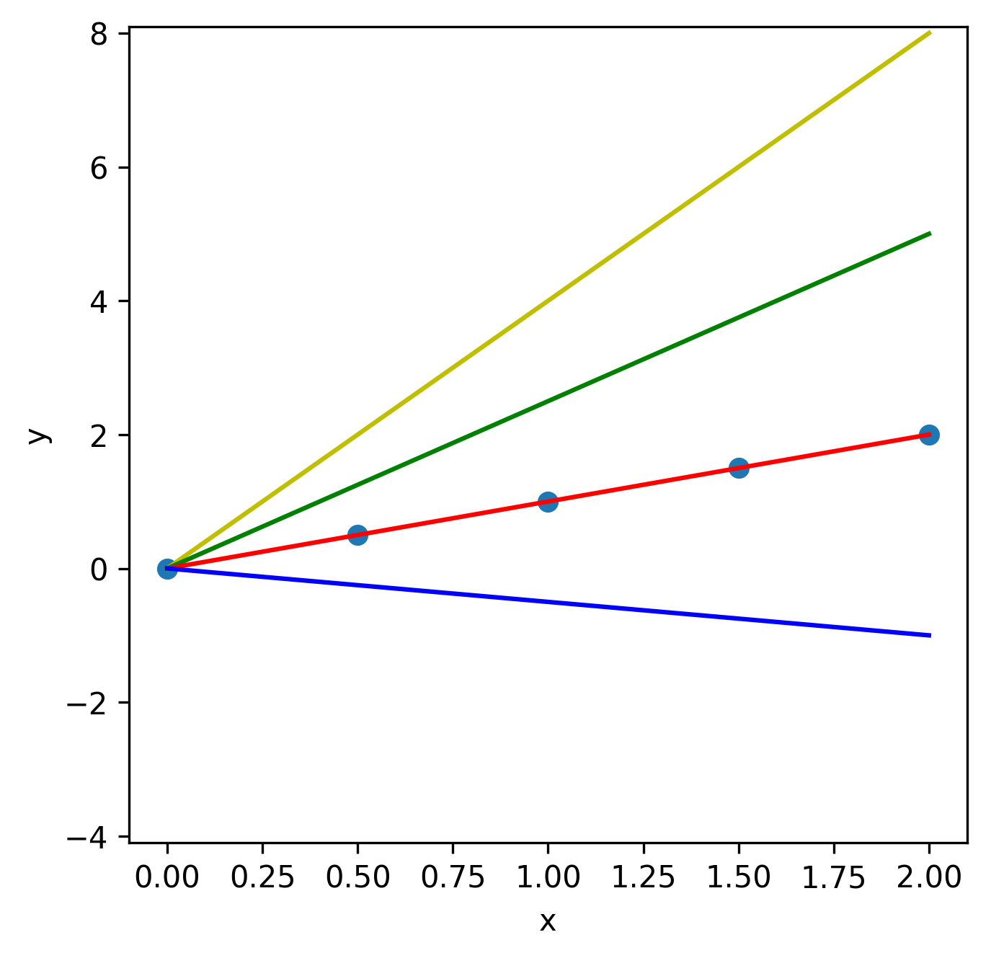
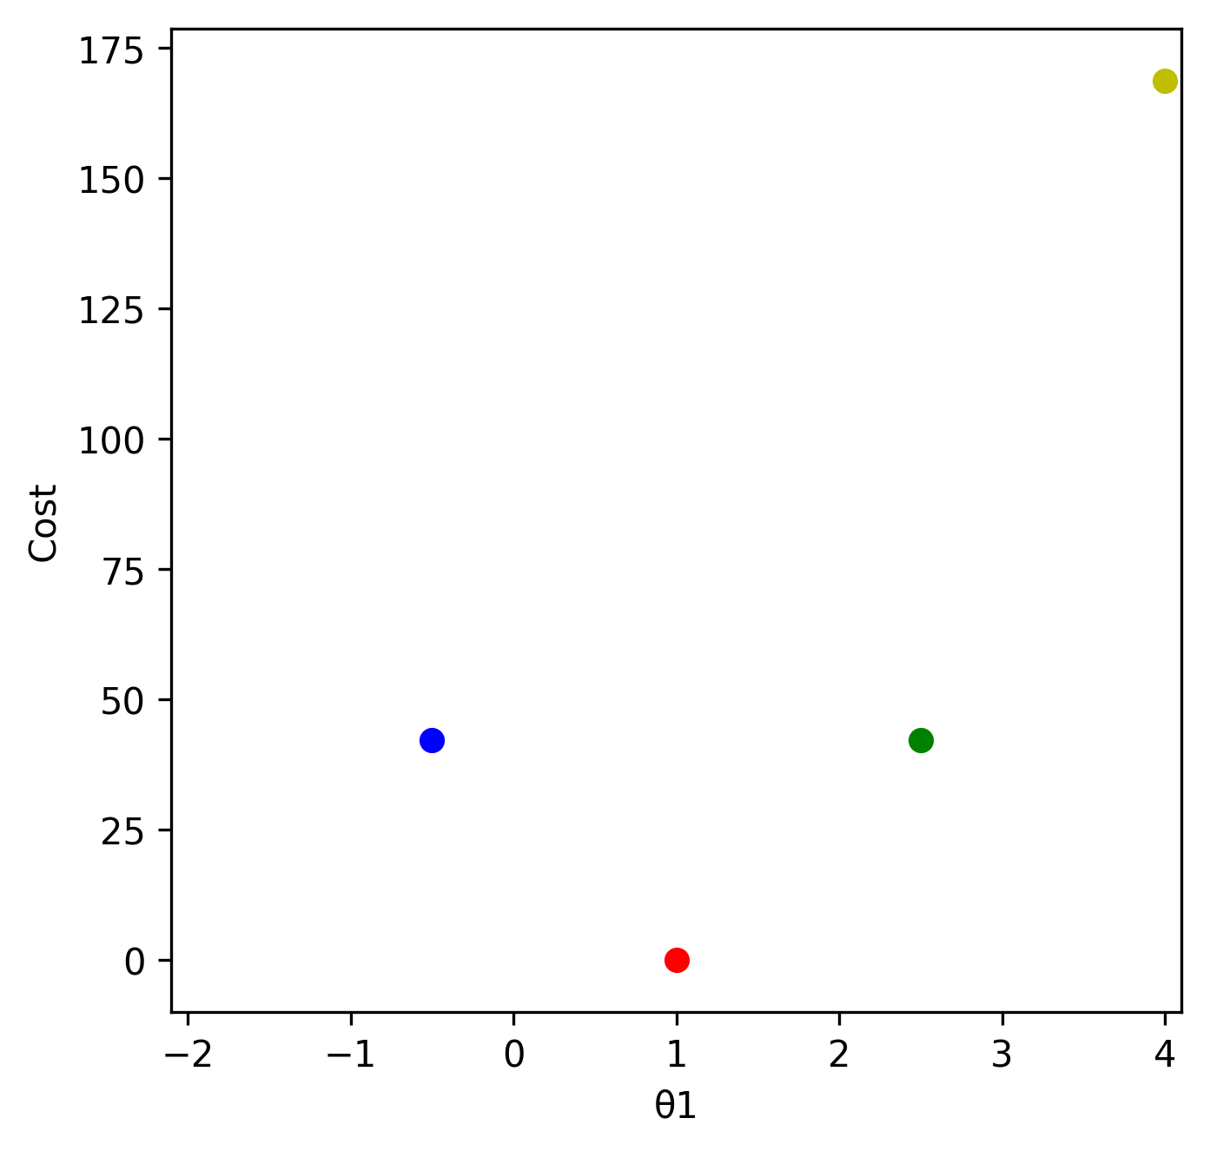
Minimize a simplified J
$$\frac{1}{2m}\sum_{i=1}^{m}{{(0+θ_{1}x^{(i)}−y^{\left(i\right)})}^{2}}$$
$$J\left(0,θ_{1}\right)=$$

Slide 15
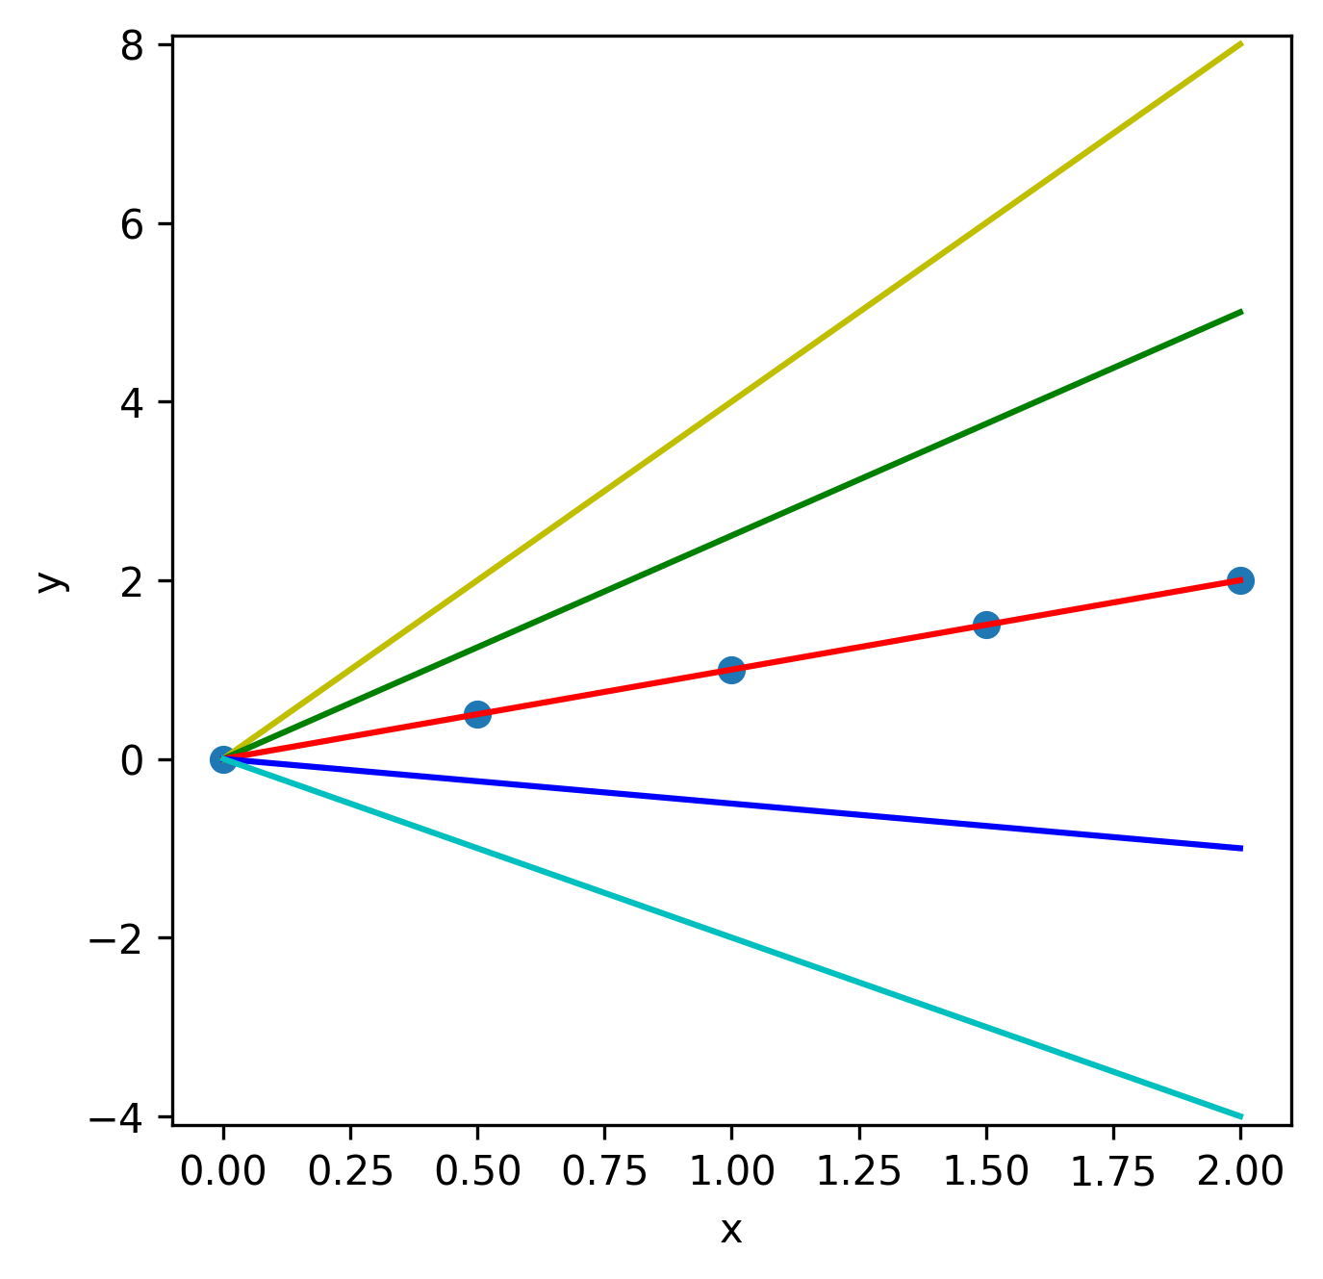
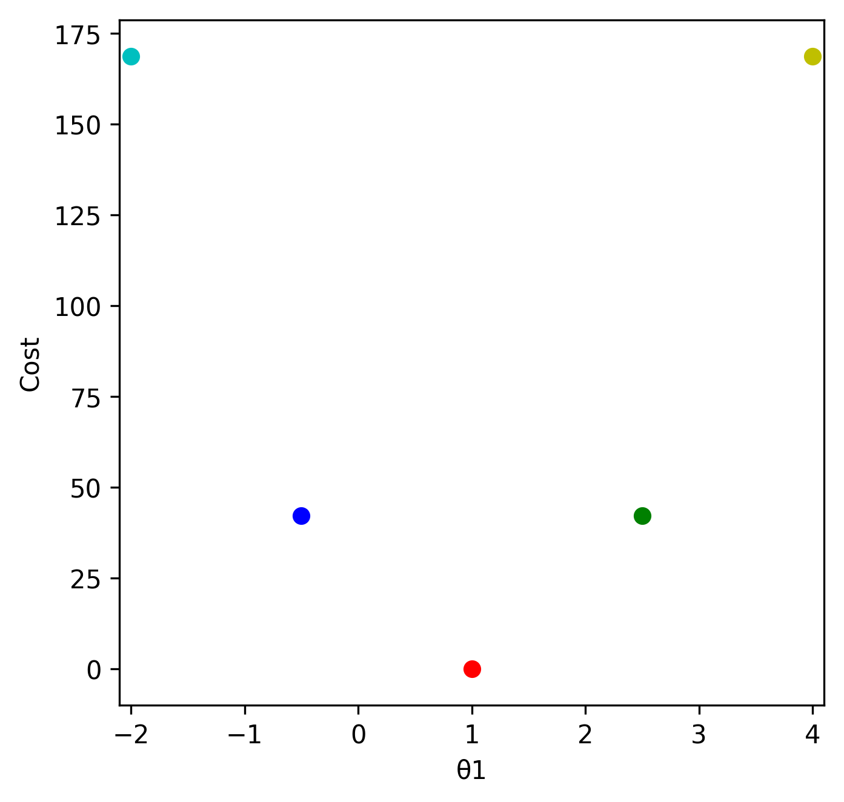
Minimize a simplified J
$$\frac{1}{2m}\sum_{i=1}^{m}{{(0+θ_{1}x^{(i)}−y^{\left(i\right)})}^{2}}$$
$$J\left(0,θ_{1}\right)=$$

Slide 16
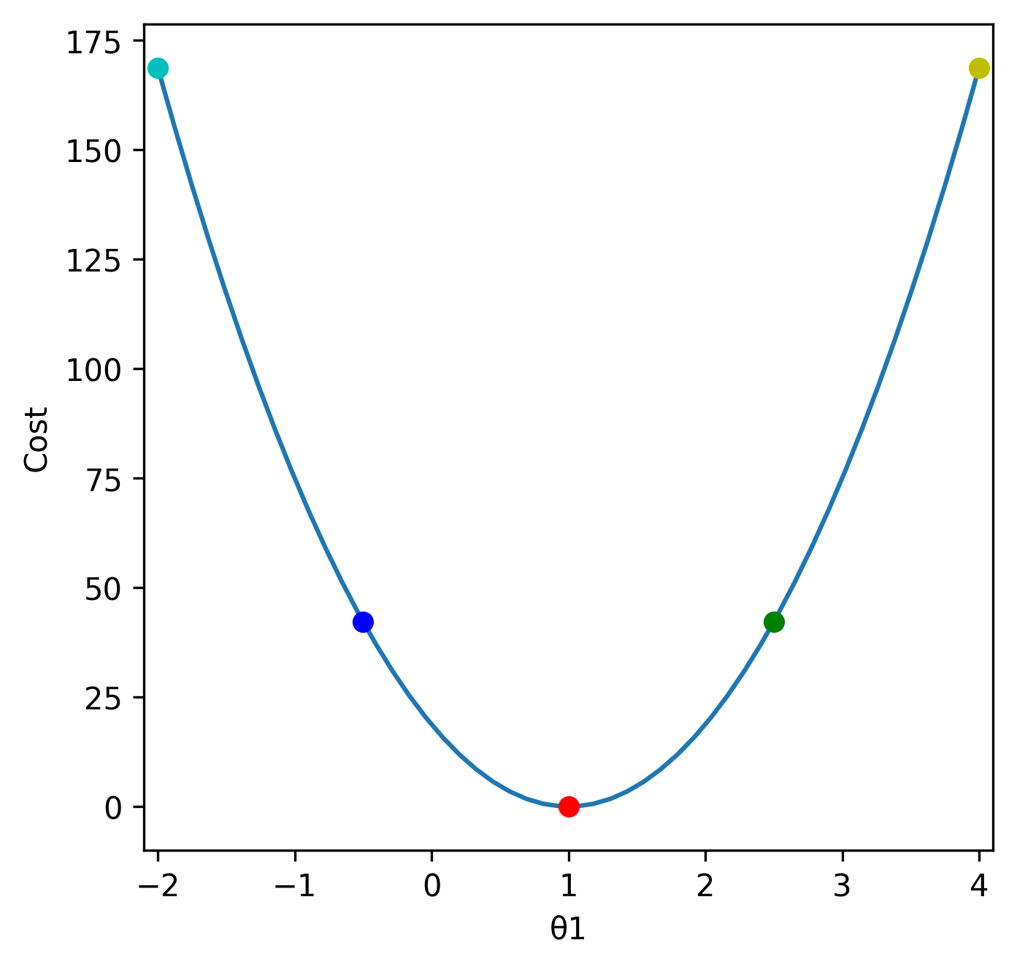
Minimize a simplified J
$$\frac{1}{2m}\sum_{i=1}^{m}{{(0+θ_{1}x^{(i)}−y^{\left(i\right)})}^{2}}$$
$$J\left(0,θ_{1}\right)=$$

Slide 17
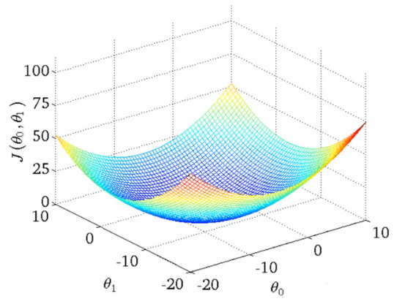
Minimize a simplified J

Slide 18
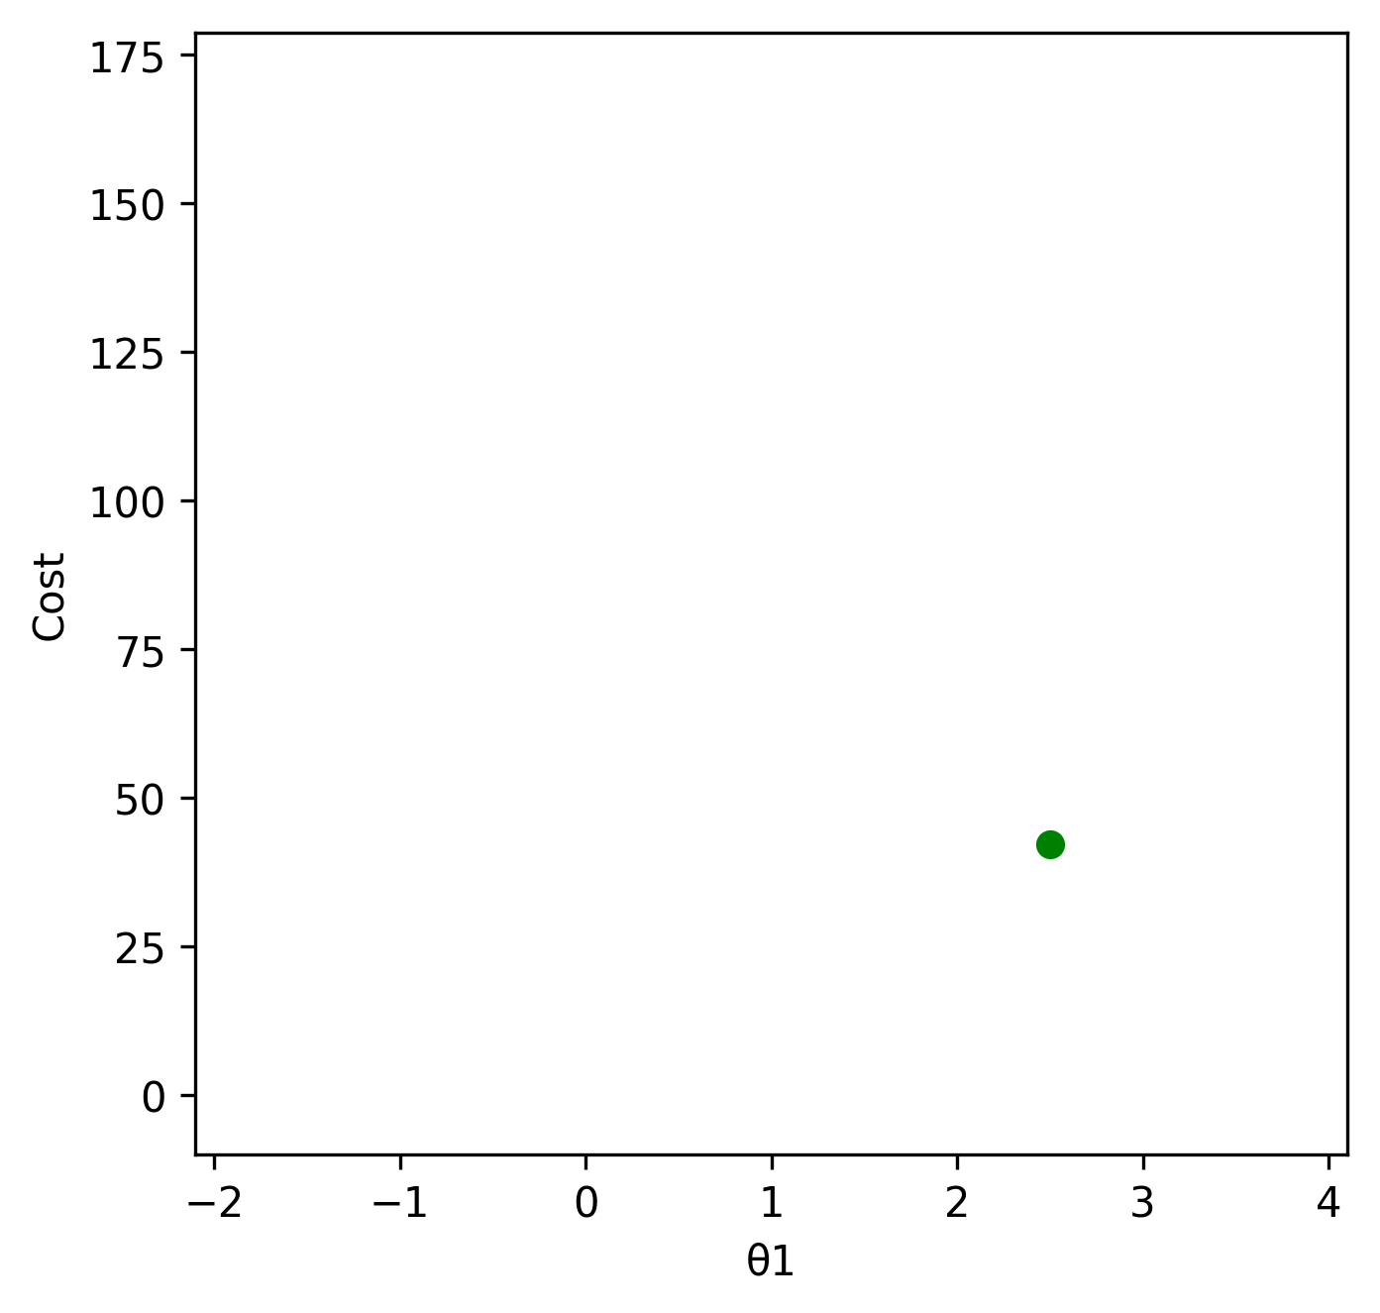
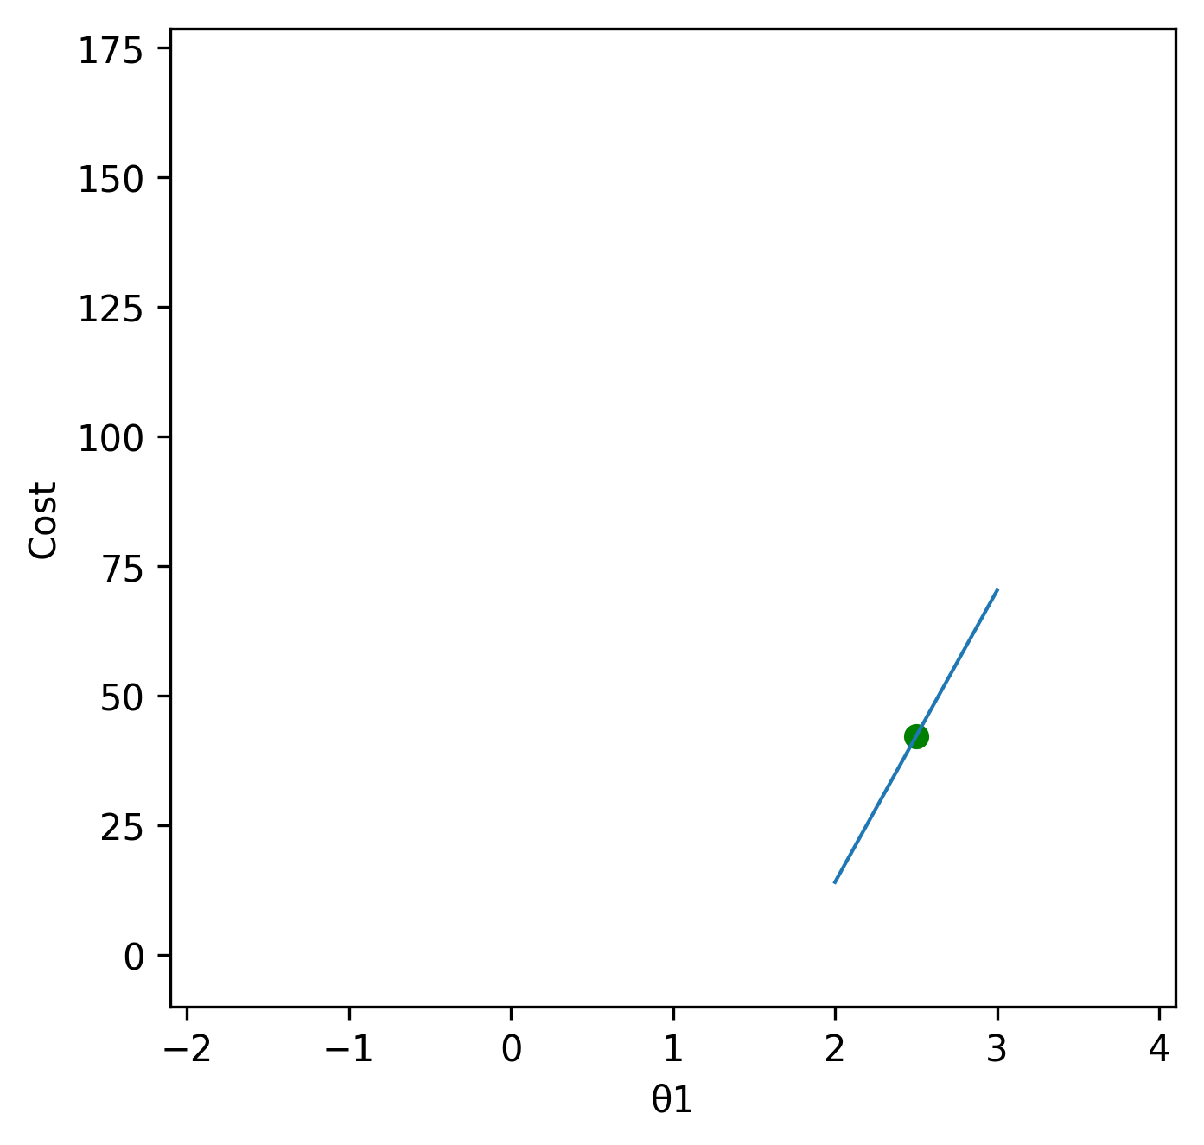
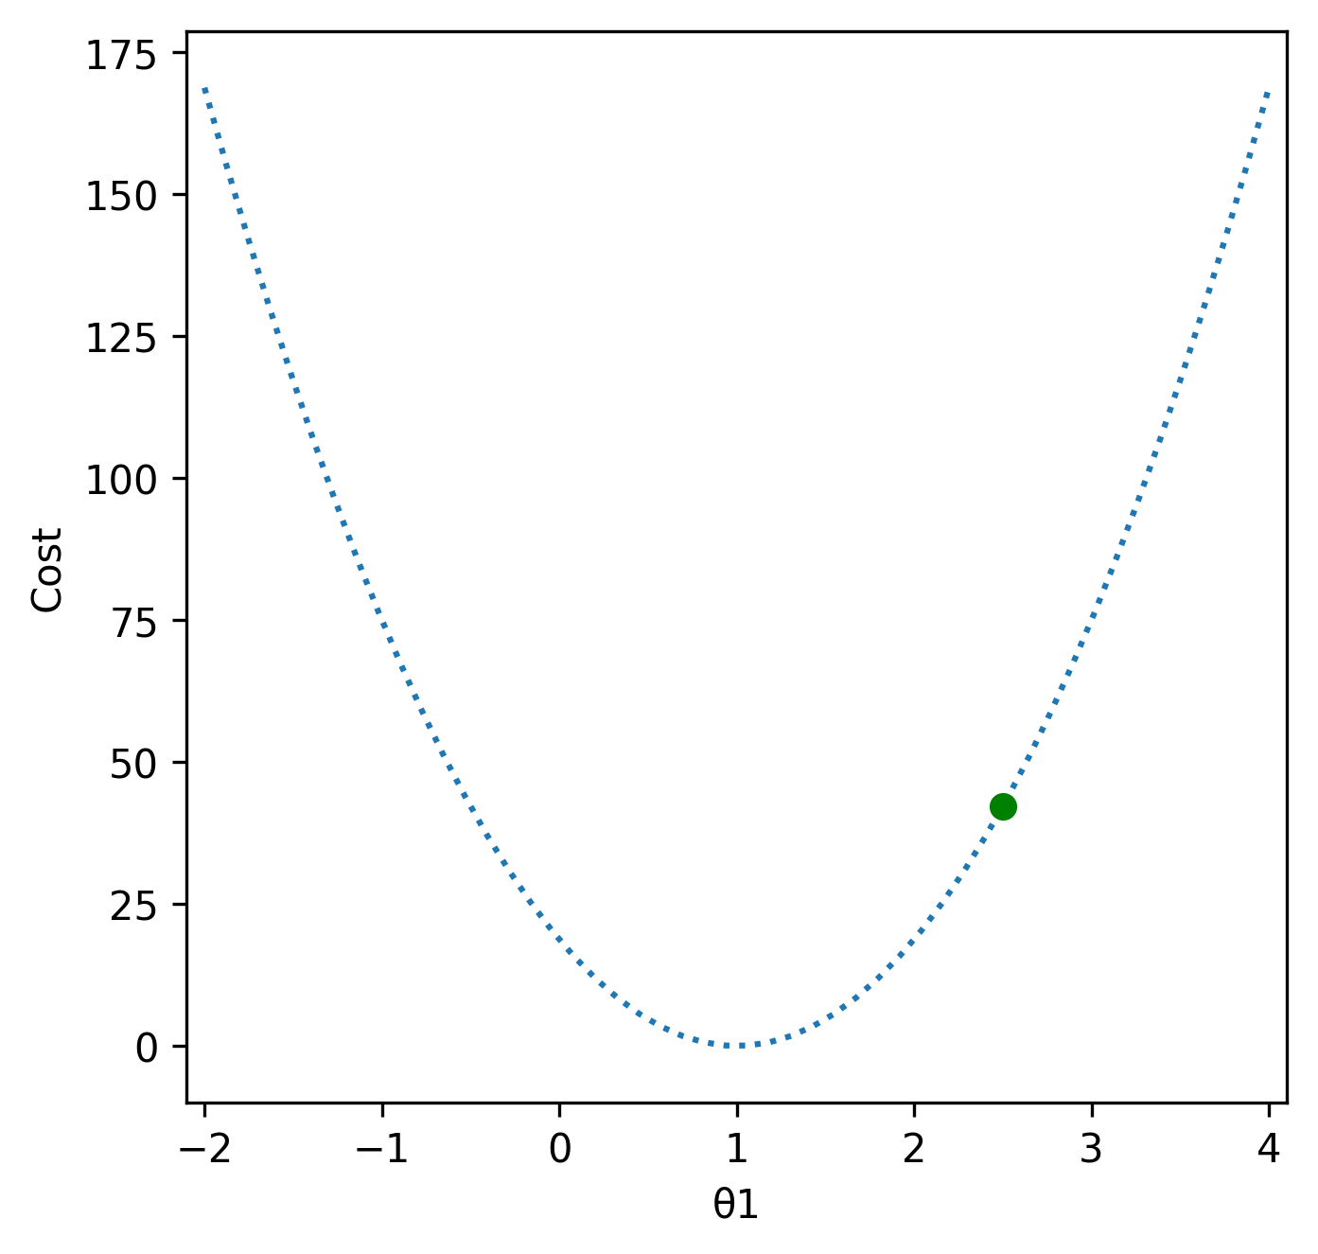
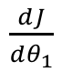
Gradient Descent
$\frac{dJ}{dθ_{1}}$
2 =
2.5 – 0.5

Slide 19
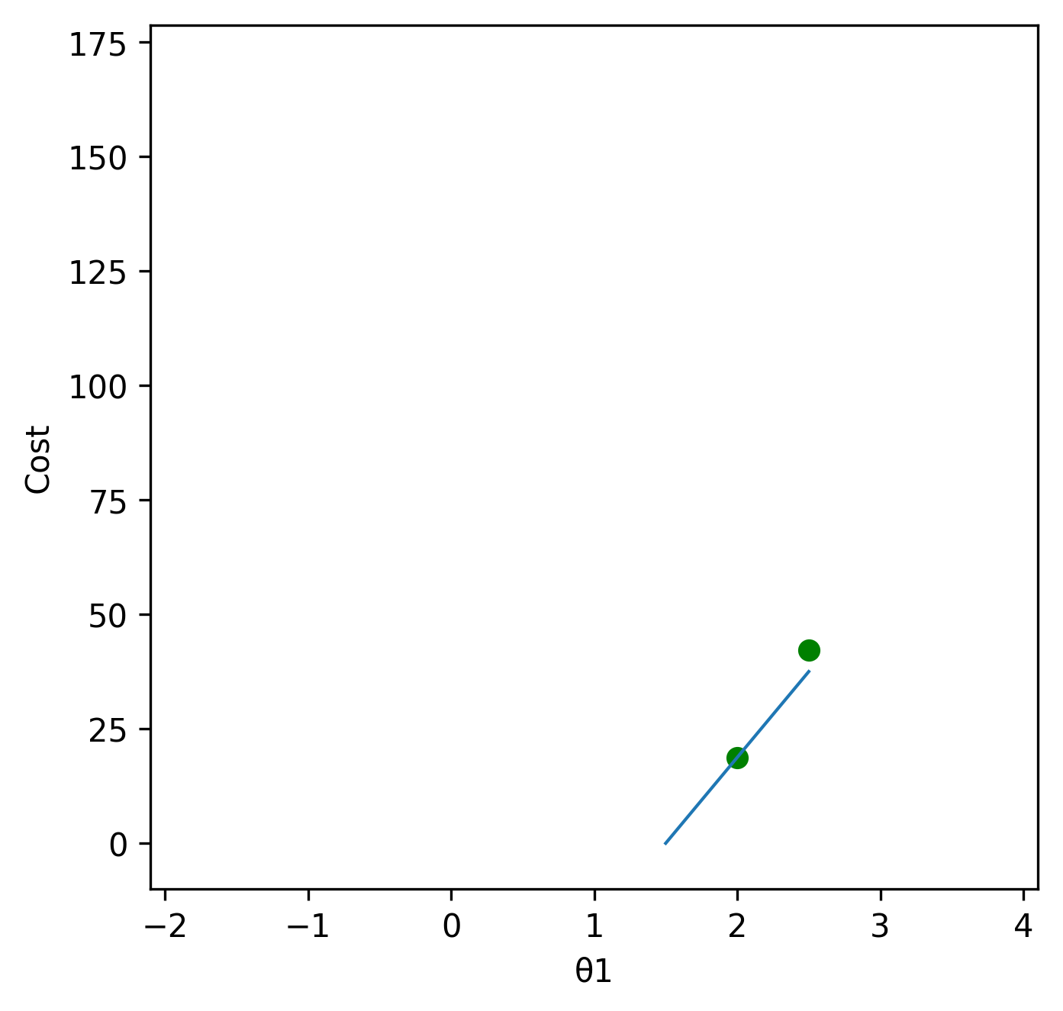
Gradient Descent
$\frac{dJ}{dθ_{1}}$
2 =
2.5 – 0.5
1.5 =
2 – 0.5

Slide 20
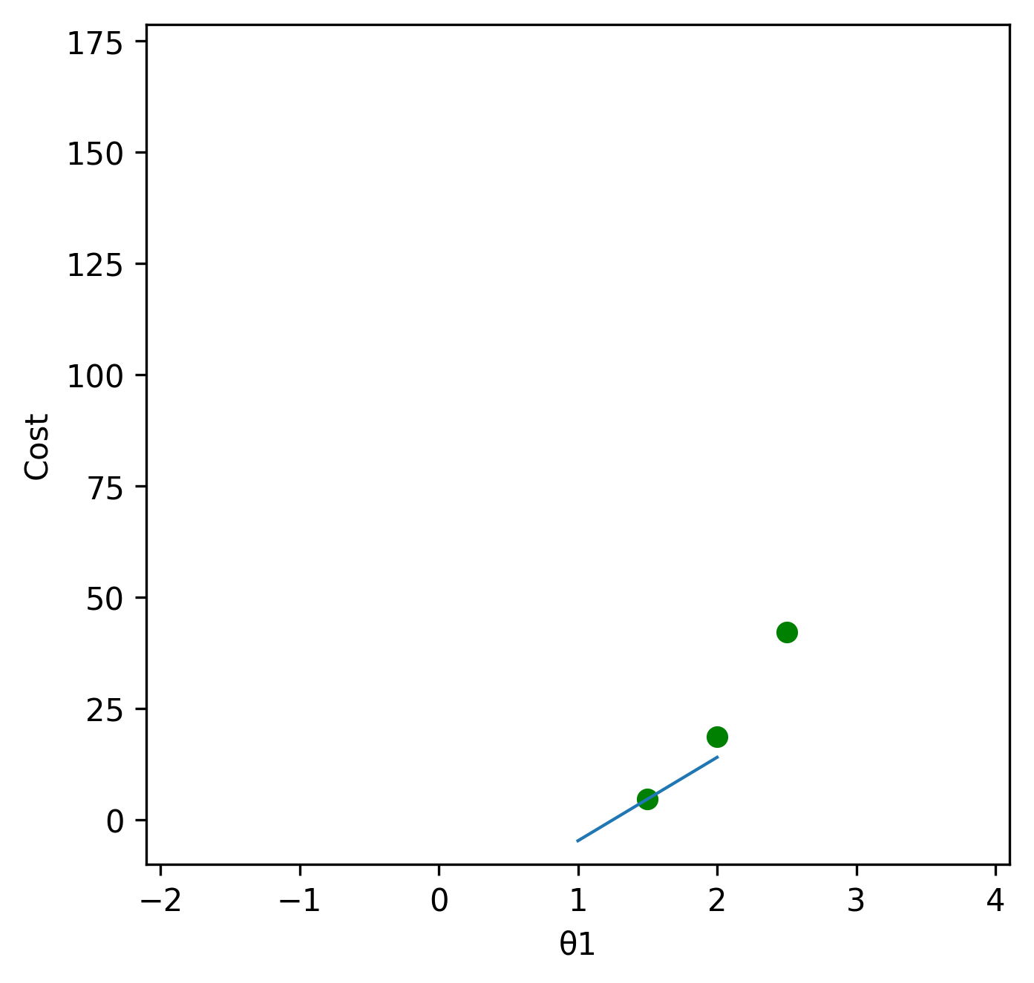
Gradient Descent
$\frac{dJ}{dθ_{1}}$
2 =
2.5 – 0.5
1.5 =
2 – 0.5
1 =
1.5 – 0.5

Slide 21
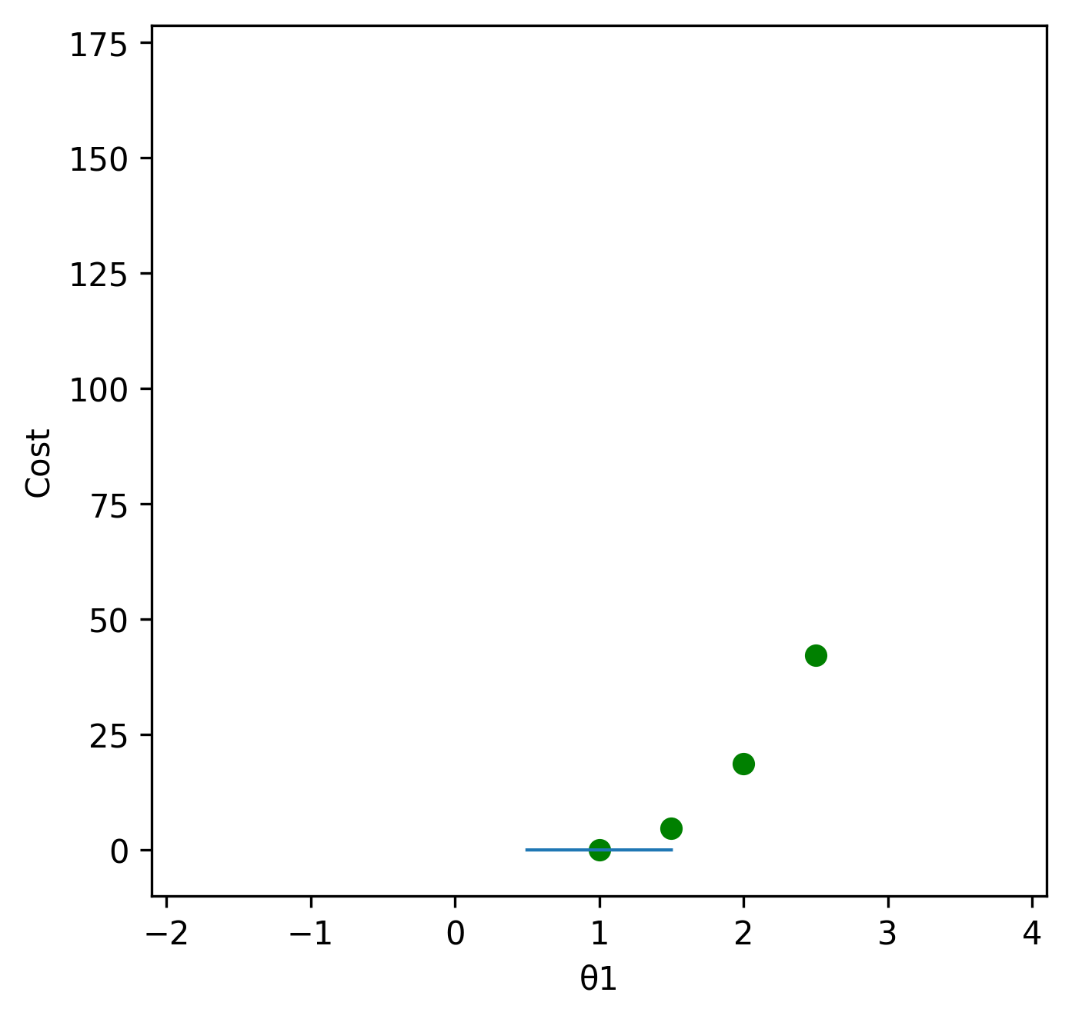
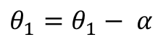
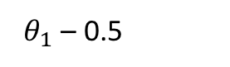
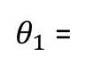
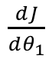
Gradient Descent
$\frac{dJ}{dθ_{1}}$
2 =
2.5 – 0.5
Repeat until convergence
Repeat until slope = 0
1.5 =
2 – 0.5
$θ_{1}$ =
$θ_{1}$ – 0.5
$$θ_{1}=θ_{1}− α$$
$\frac{dJ}{dθ_{1}}$
1 =
1.5 – 0.5

Slide 22
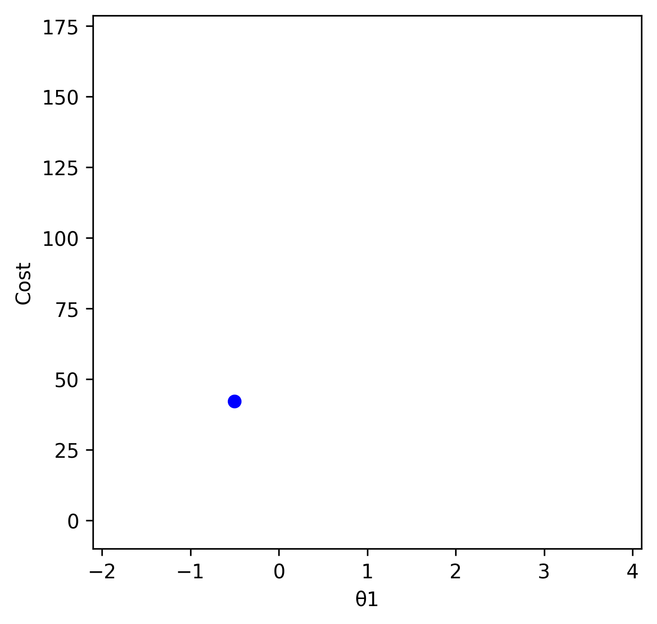
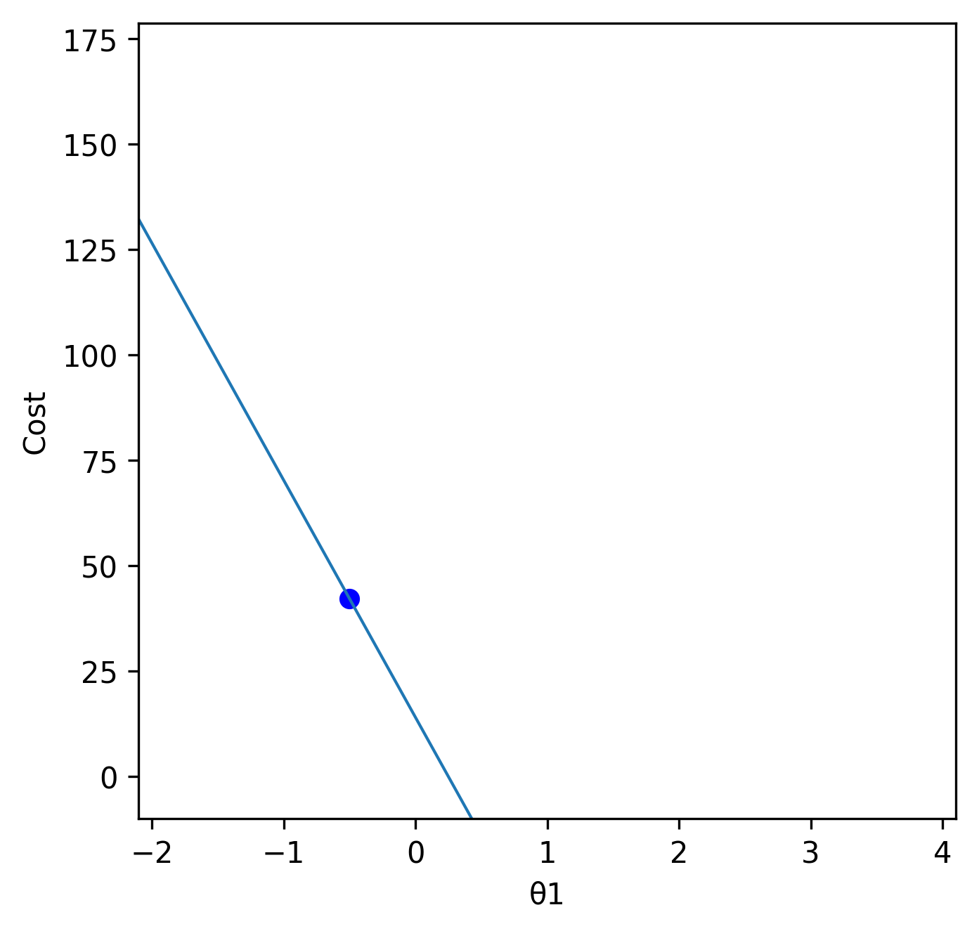
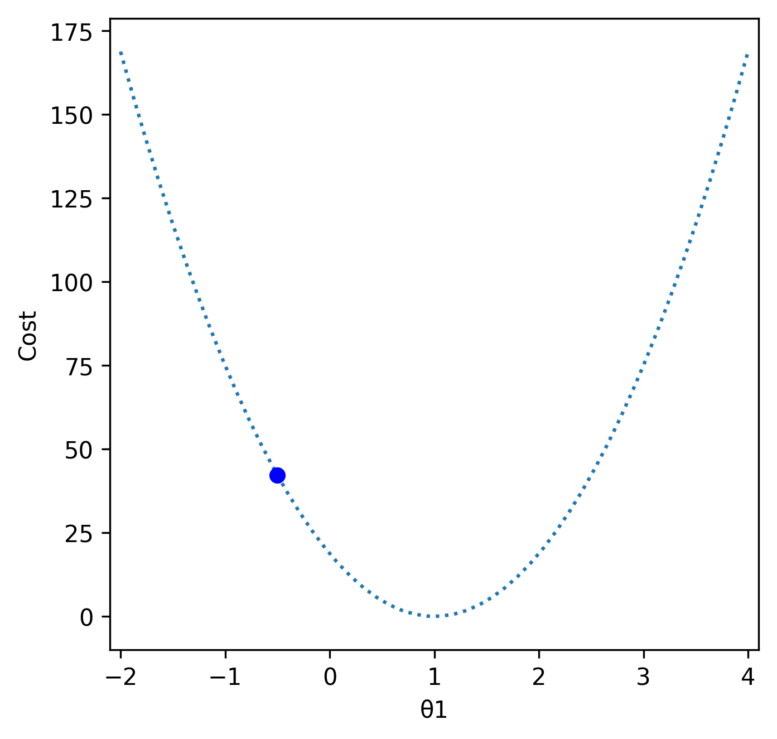


Gradient Descent
Repeat until convergence
$$θ_{1}=θ_{1}− α$$
$\frac{dJ}{dθ_{1}}$

Slide 23

















Gradient Descent
$$θ_{0}=θ_{0}− α\frac{∂J}{∂θ_{0}}$$
$$\frac{1}{2m}\sum_{i=1}^{m}{{( θ_{0}+θ_{1}x^{(i)}−y^{\left(i\right)})}^{2}}$$
$$J\left(θ_{0},θ_{1}\right)=$$
$$θ_{1}=θ_{1}− α\frac{∂J}{∂θ_{1}}$$
$$\frac{∂J}{∂θ_{0}}$$
$$=\frac{1}{m}\sum_{i=1}^{m}{\left( θ_{0}+θ_{1}x^{\left(i\right)}−y^{\left(i\right)}\right)}$$
$$∗1$$
$$θ_{2}=θ_{2}− α\frac{∂J}{∂θ_{2}}$$
$$\frac{∂J}{∂θ_{1}}$$
$$= \frac{1}{m}\sum_{i=1}^{m}{\left( θ_{0}+θ_{1}x^{\left(i\right)}−y^{\left(i\right)}\right)}$$
$${ ∗x}^{\left(i\right)}$$
Repeat until convergence
$$\frac{α}{m}\sum_{i=1}^{m}{\left( θ_{0}+θ_{1}x^{\left(i\right)}−y^{\left(i\right)}\right)}$$
$$θ_{j}=θ_{j}− α\frac{∂J}{∂θ_{j}}$$
j = 0,1,2…
$$θ_{0}=θ_{0}−$$
$$\frac{α}{m}\sum_{i=1}^{m}{\left( θ_{0}+θ_{1}x^{\left(i\right)}−y^{\left(i\right)}\right)}$$
$$θ_{1}=θ_{1}−$$
$${ ∗x}^{\left(i\right)}$$

Slide 24












Dot product
$θ_{0}$ + $θ_{1}∗x=y$
y = 2x -1
?
$(−1)$+ (2) $∗x=y$
$\left(−1\right)∗1$+ (2) $∗x=y$
-1
0
1
3
4
-3
-1
1
5
7
$\left(−1\right)∗1$+ (2) $∗(−1)=(3)$
$\left(−1\right)∗1$+ (2) $∗(0)=(−1)$
$\left(−1\right)∗1$+ (2) $∗(1)=(1)$
$\left(−1\right)∗1$+ (2) $∗(3)=(5)$
$\left(−1\right)∗1$+ (2) $∗(4)=(7)$
$$\left[\begin{matrix}1 & −1 \\ \begin{aligned}1 \\ 1 \\ 1 \\ 1\end{aligned} & \begin{aligned}0 \\ 1 \\ 3 \\ 4\end{aligned}\end{matrix}\right]$$
$$\left[\begin{matrix}3 \\ −1 \\ \begin{aligned}1 \\ 5 \\ 7\end{aligned}\end{matrix}\right]$$
$$∙\left[\begin{matrix}−1 \\ 2\end{matrix}\right]=$$
$$X ∙θ=y$$

Slide 25
The Challenge
$$\frac{1}{2m}\sum_{i=1}^{m}{{( θ_{0}+θ_{1}x^{(i)}−y^{\left(i\right)})}^{2}}$$
$$J\left(θ_{0},θ_{1}\right)=$$
$$\frac{α}{m}\sum_{i=1}^{m}{\left( θ_{0}+θ_{1}x^{\left(i\right)}−y^{\left(i\right)}\right)}$$
$$θ_{0}=θ_{0}−$$
$$\frac{α}{m}\sum_{i=1}^{m}{\left( θ_{0}+θ_{1}x^{\left(i\right)}−y^{\left(i\right)}\right)}$$
$$θ_{1}=θ_{1}−$$
$${ ∗x}^{\left(i\right)}$$
Repeat until convergence

